Slide 1
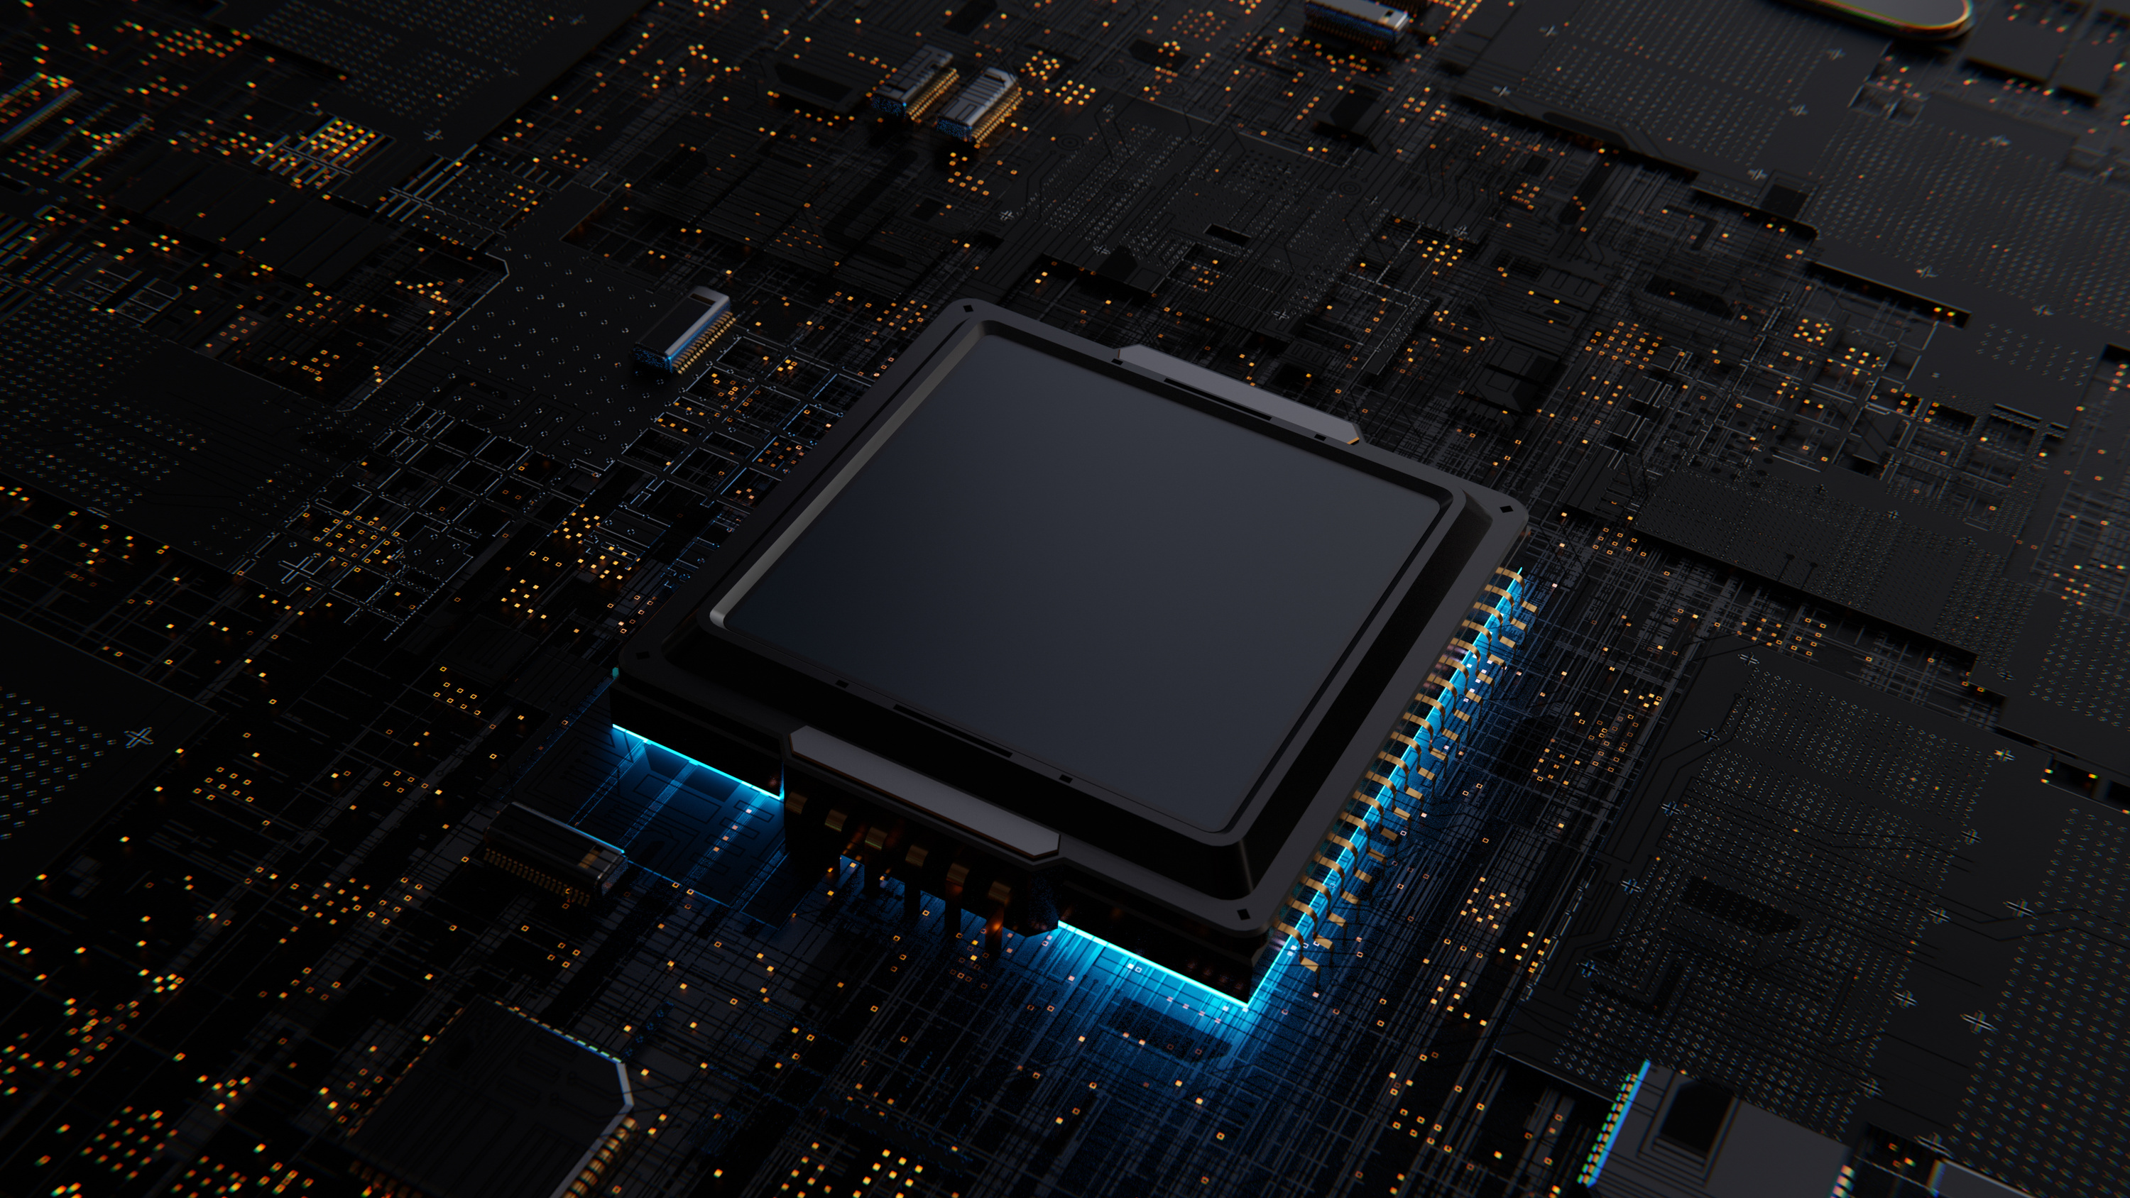
MonoWheel
robot
ROCO507Z ADVANCED ROBOT DESIGN & PROTOTYPING

Slide 2
Team
Yasas Chandrasena (10940925)
Sudeera Milakshan (10948185)
Puranjana Wijayarathna (10942674)
Tanvibahen Lakhani (10937718)
Himeth Sanjula (10749155)

Slide 3

overview
A single wheel robot which is capable of;
Self Balancing
Step Climbing

Slide 4
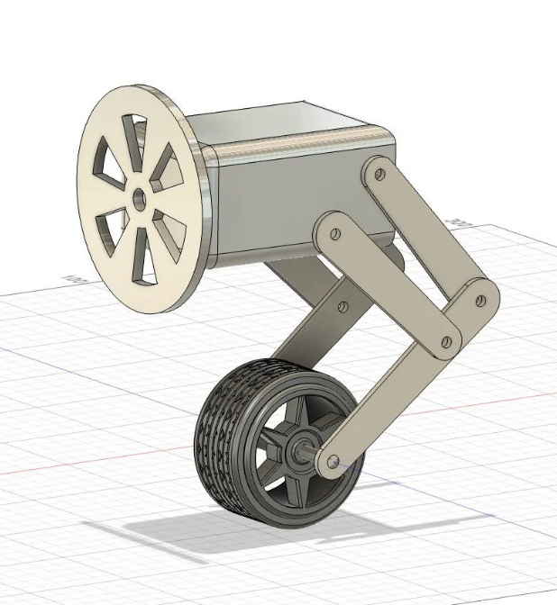
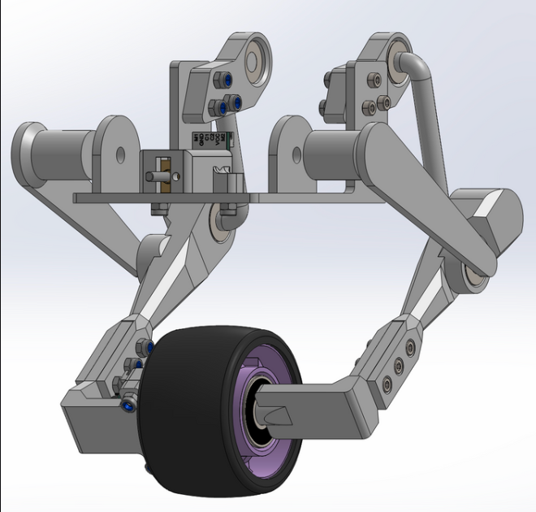
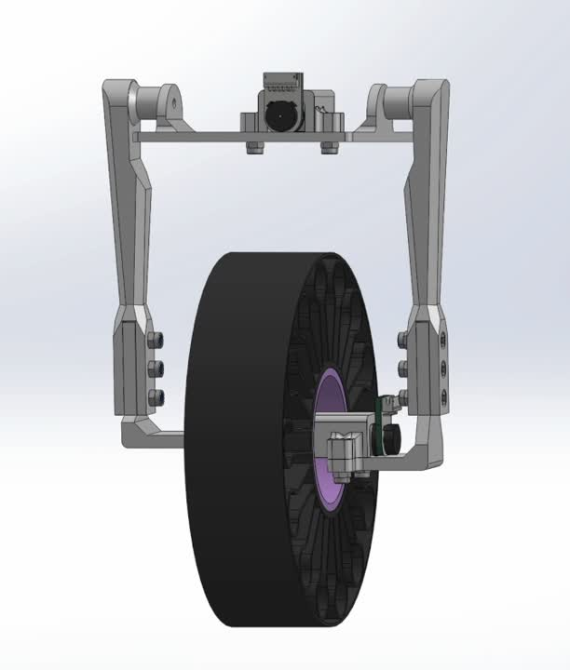
Recap

Slide 5
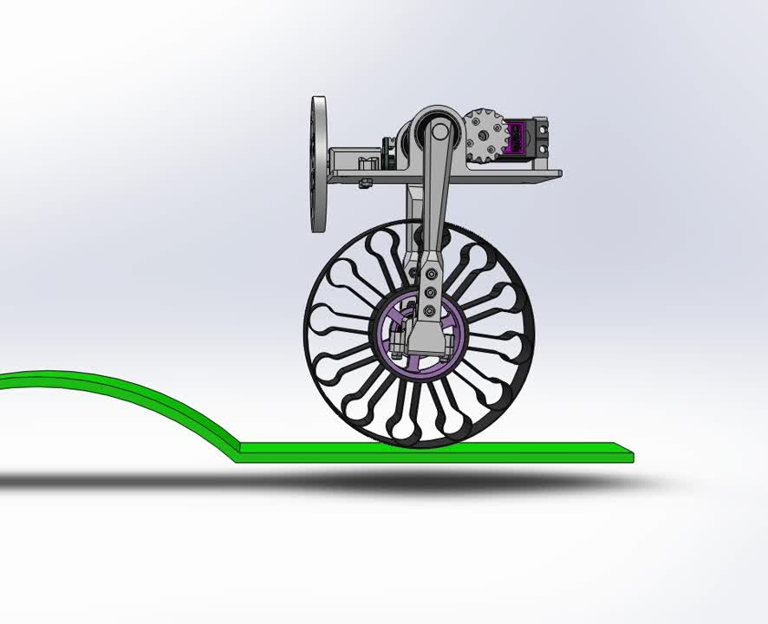
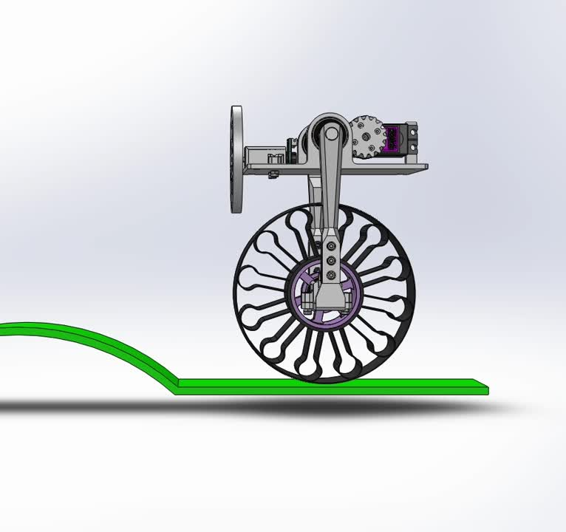
Simulation

Slide 6
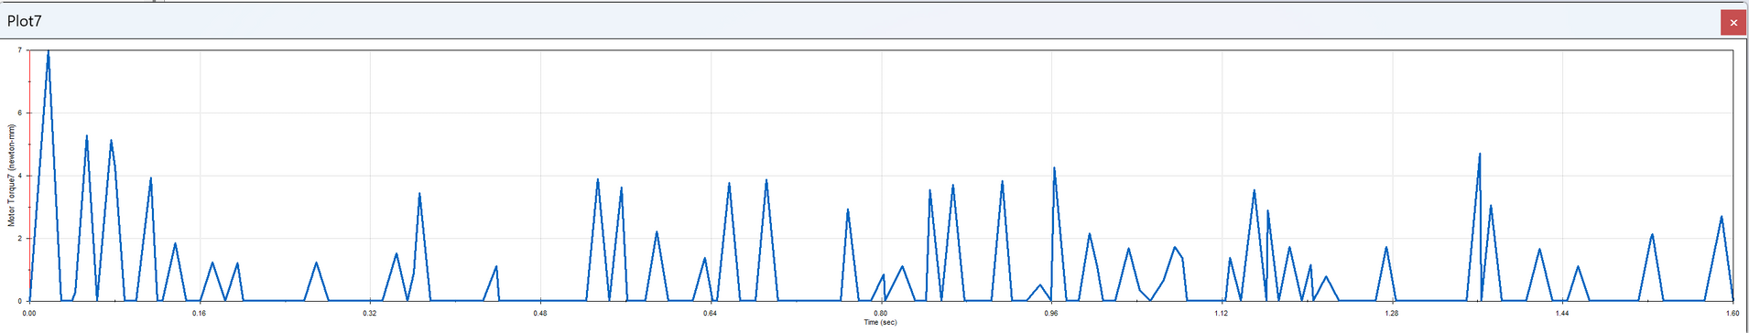
Simulation

Slide 7
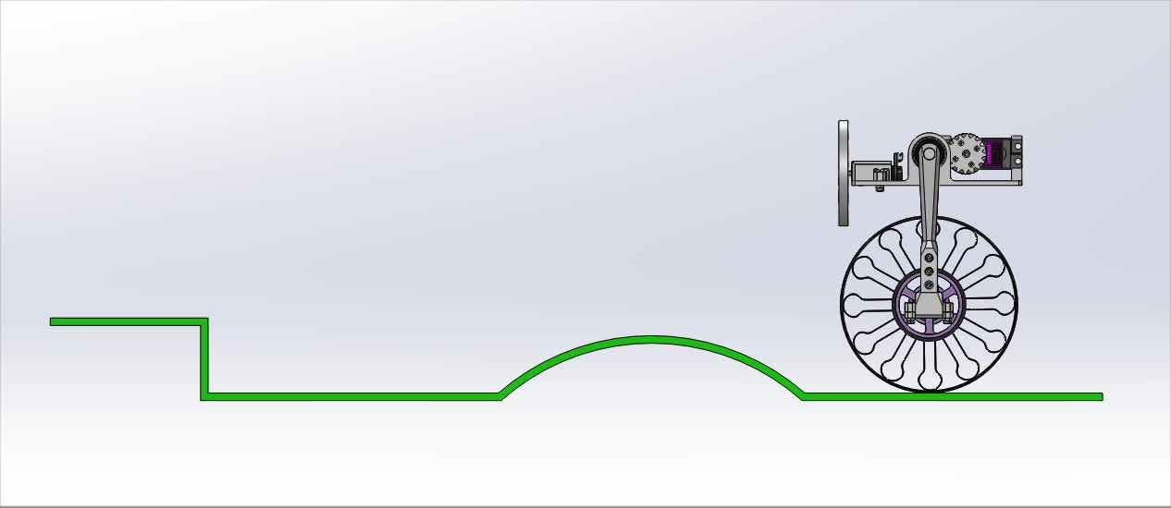
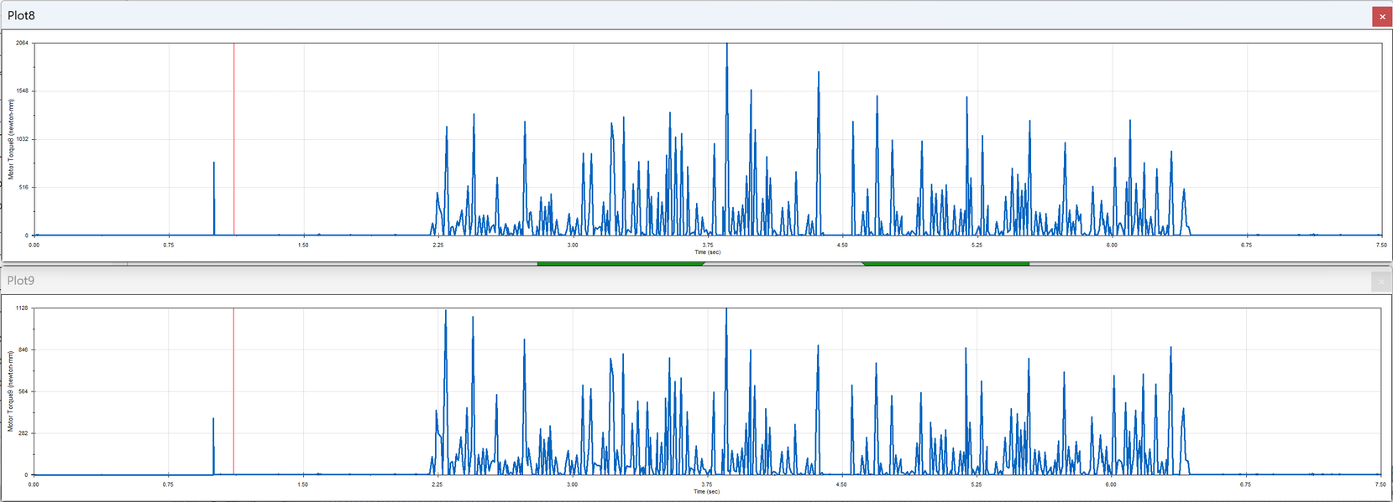
Simulation

Slide 8
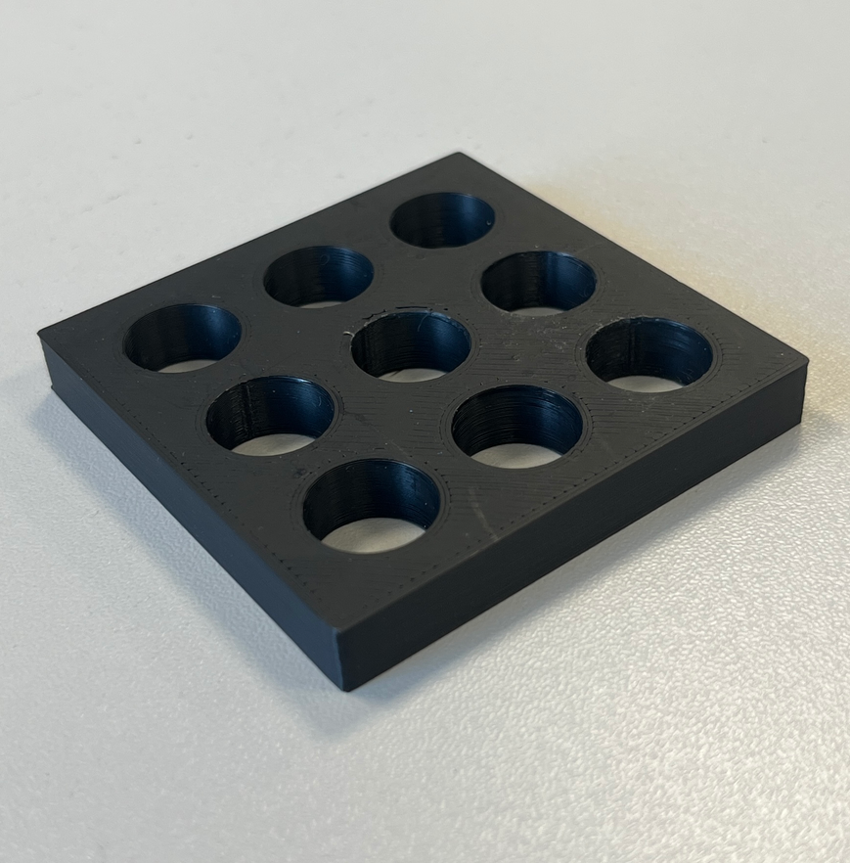
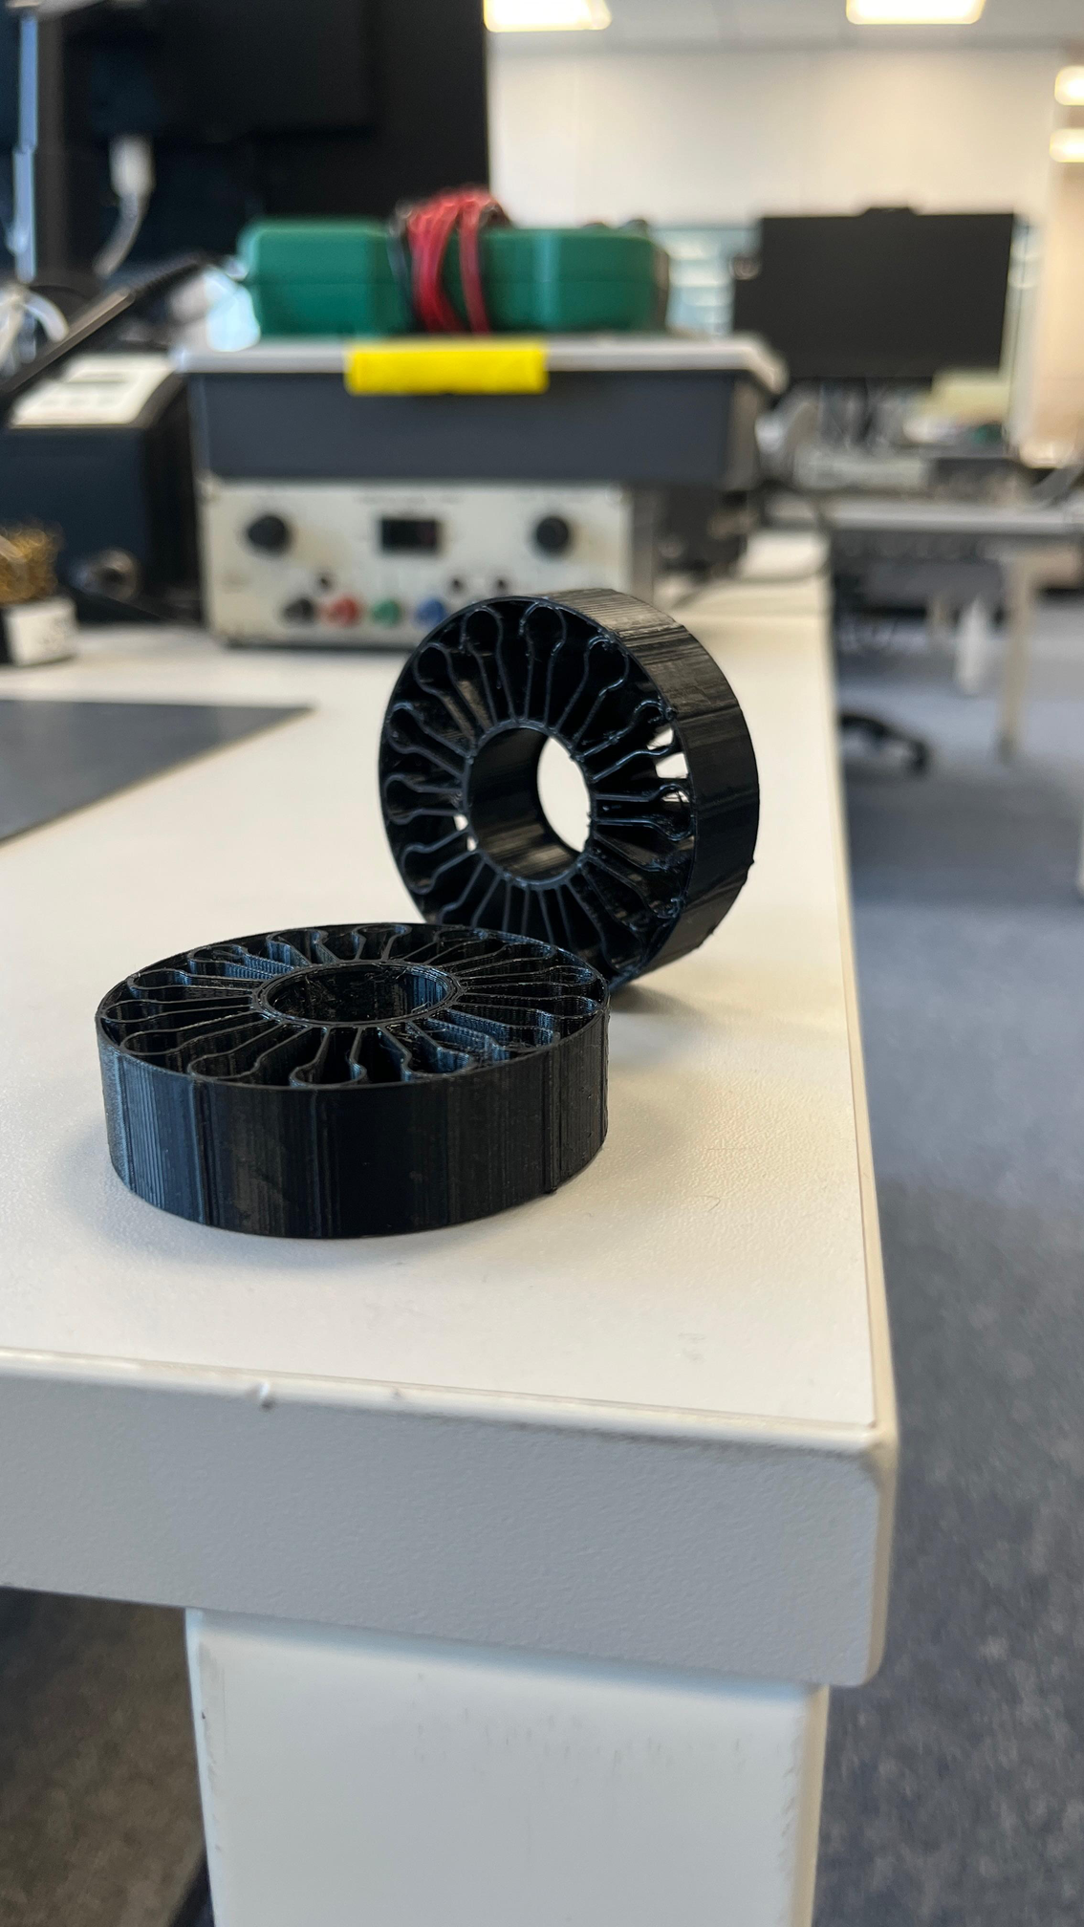
Mechanical Fabrication

Slide 9
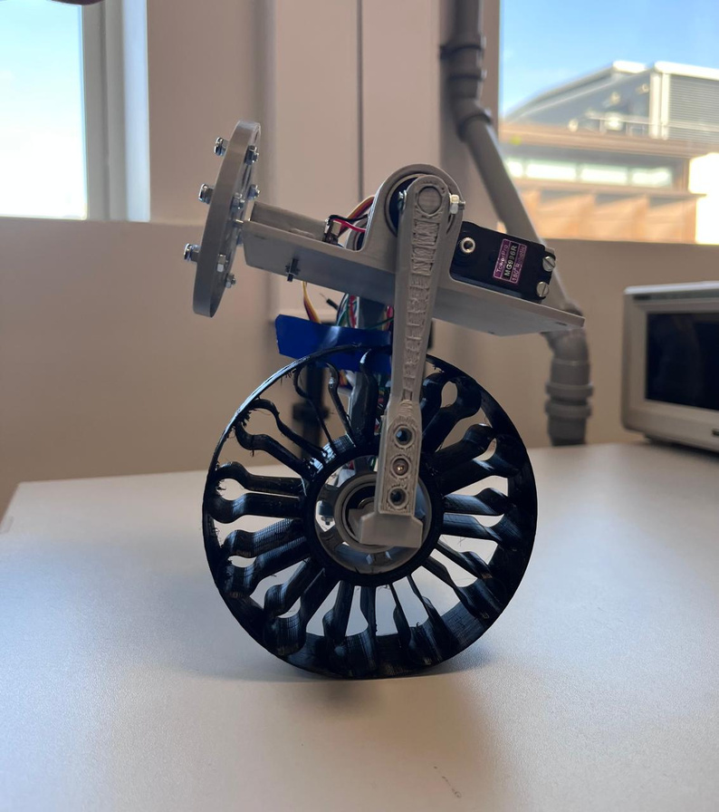
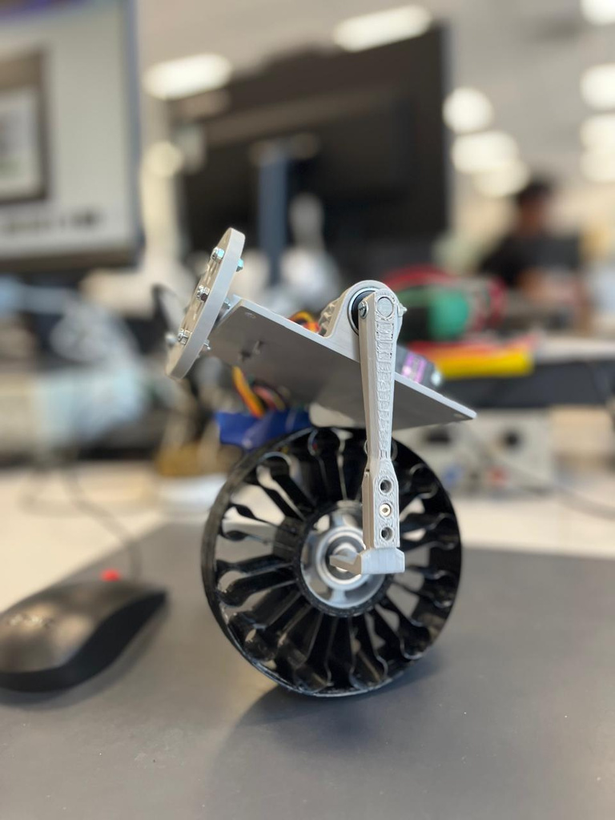
Mechanical Fabrication

Slide 10
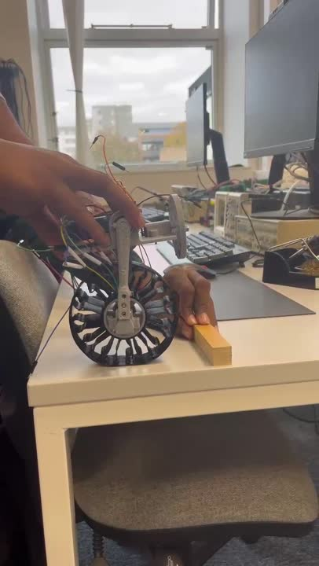
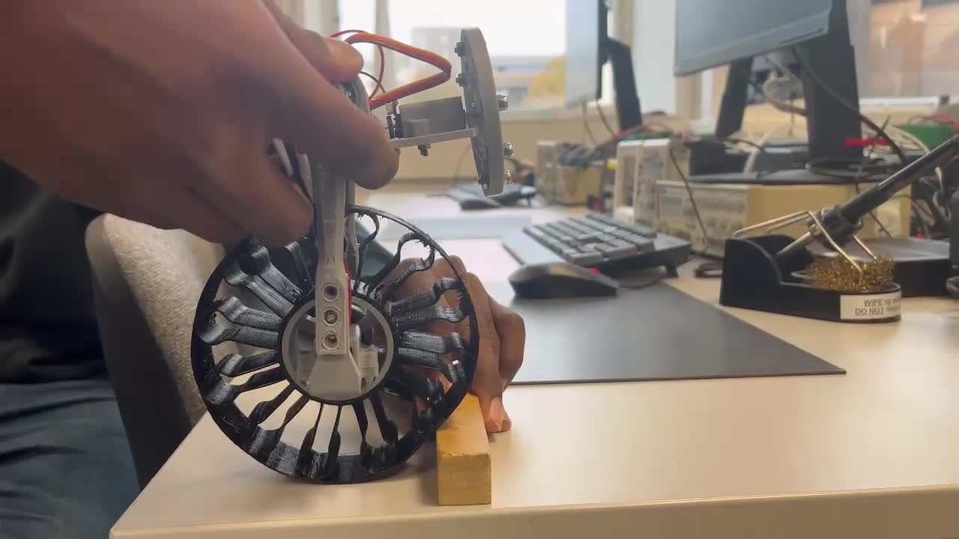
Mechanical Assembly

Slide 11
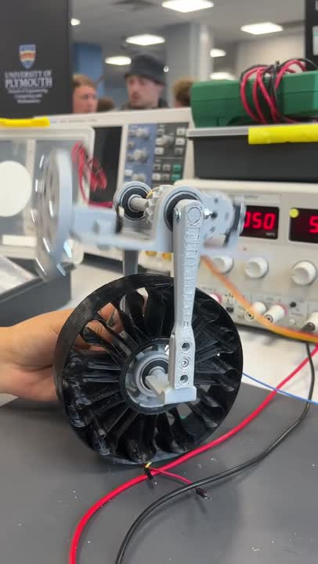
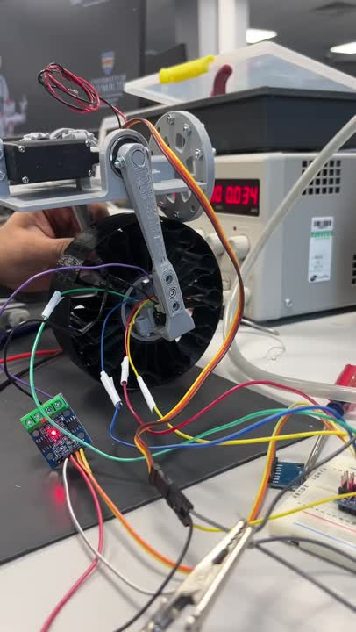
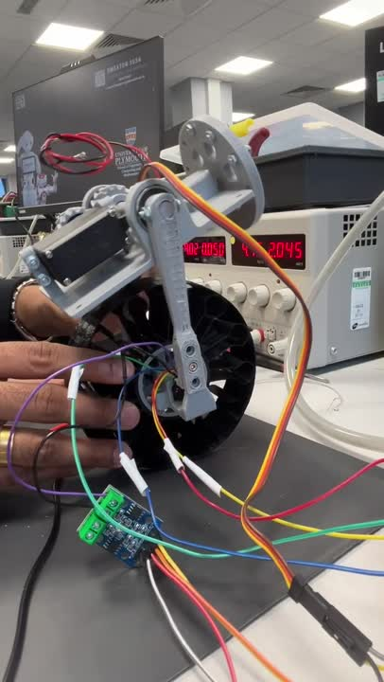
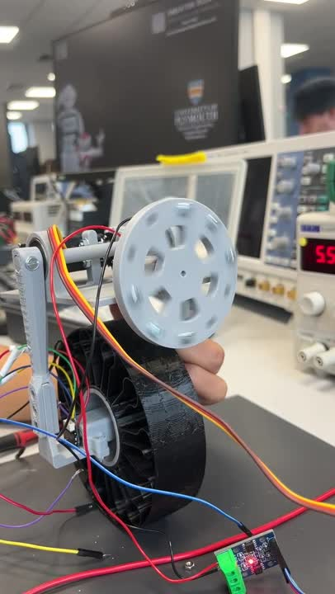
Mechanical Assembly

Slide 12
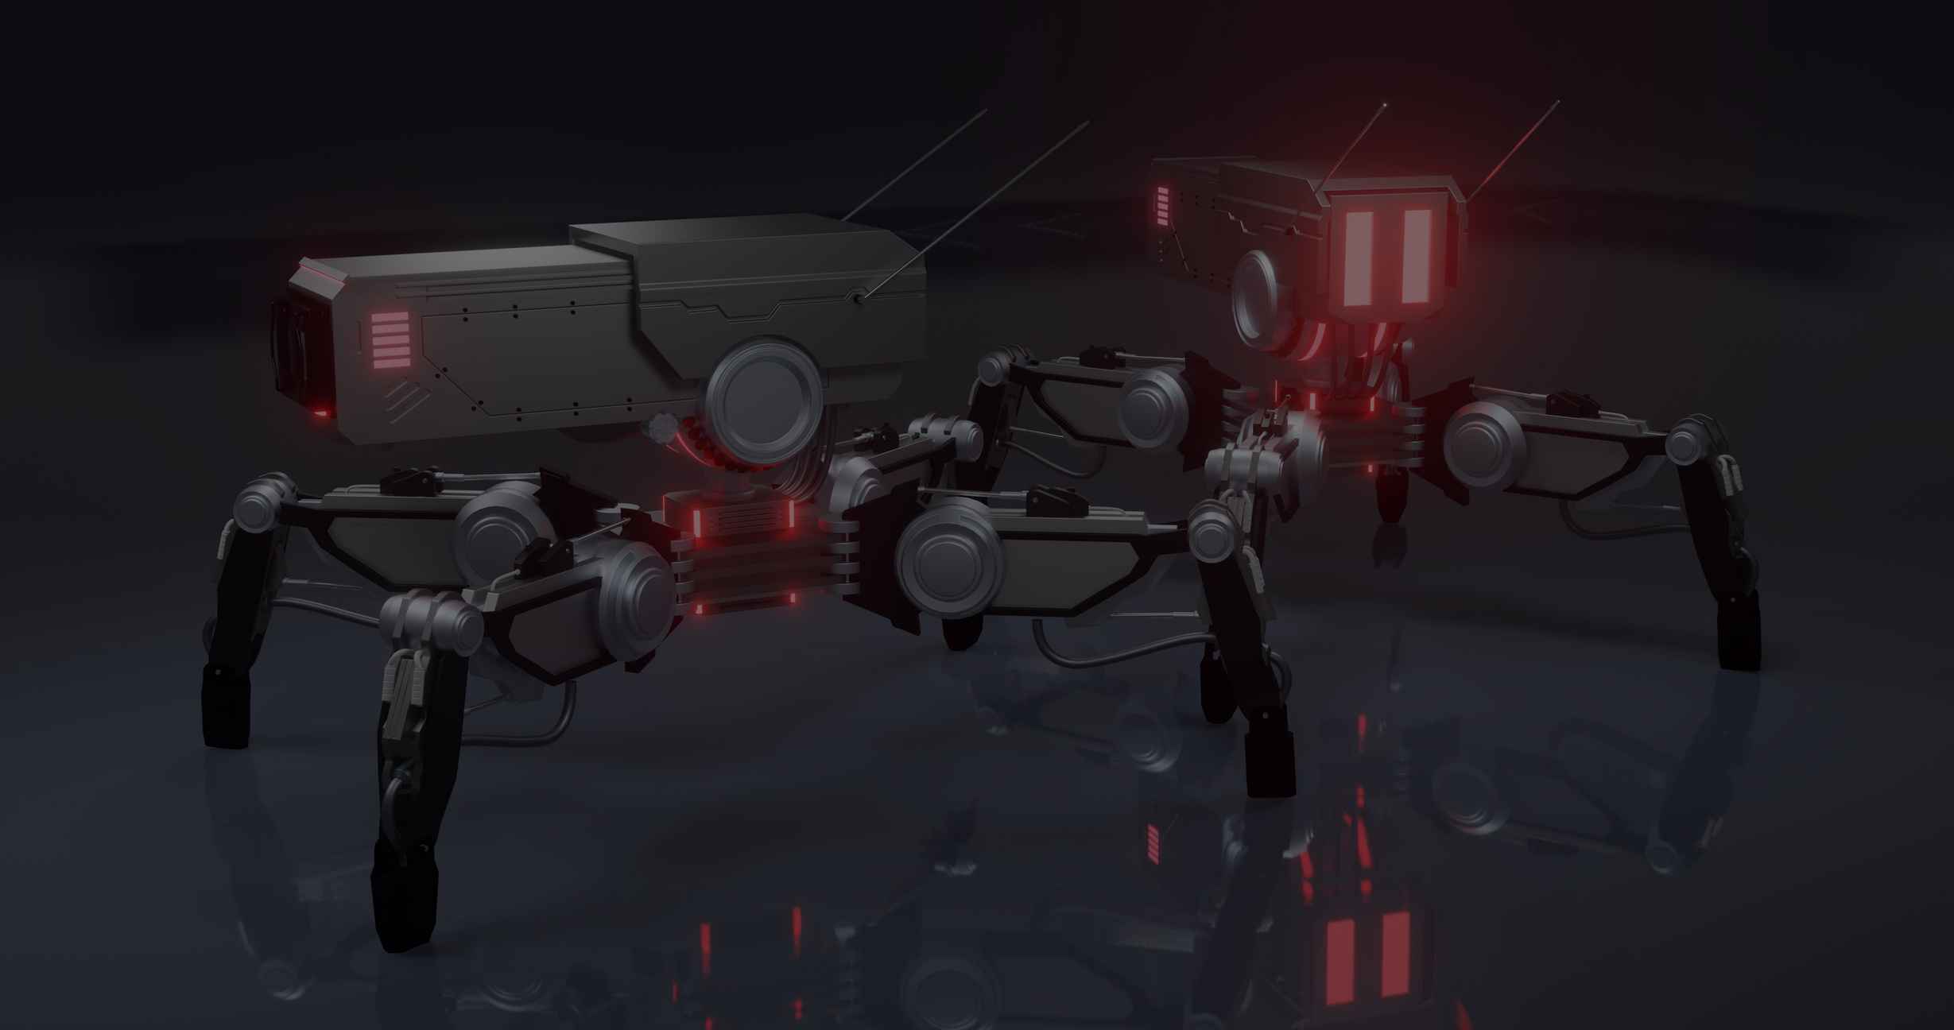
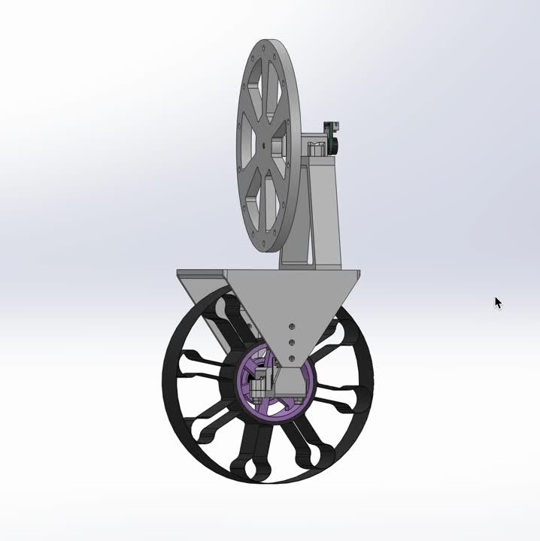
DESIGN IMPROVEMEntS

Slide 13

Thank You
FOR YOUR ATTENTION

